Slide 1


Data
Analysis

Slide 2


Today's agenda
Project recap
Problem
The Analytics team
Process
Insights
Summary

Slide 3


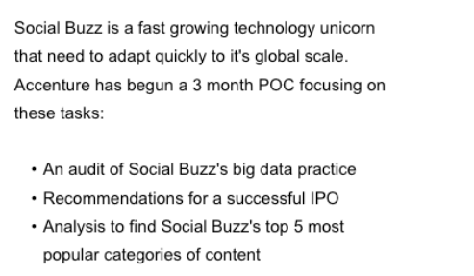
ss
Project Recap

Slide 4


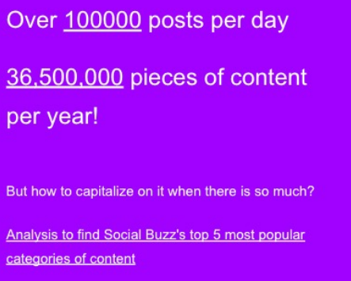
Problem

Slide 5




The Analytics team

Slide 6






Process
1
2
3
4
5

Slide 7
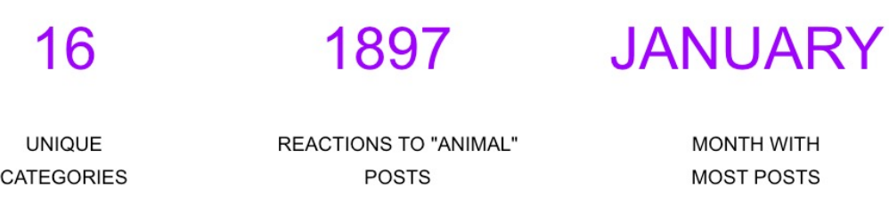


Insights

Slide 8
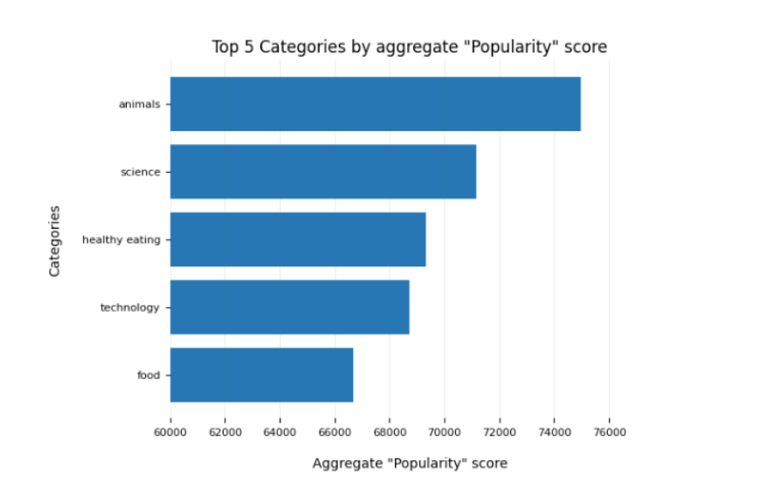

Slide 9
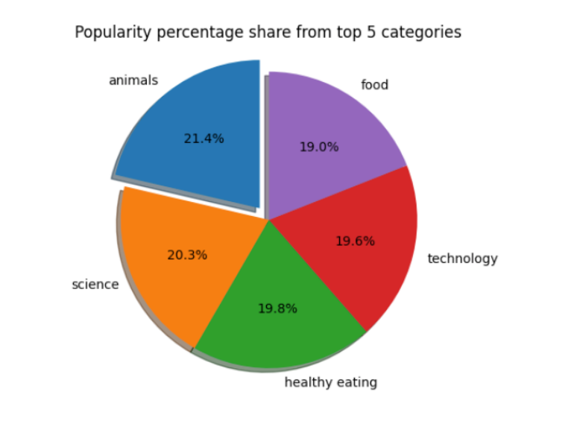

Slide 10

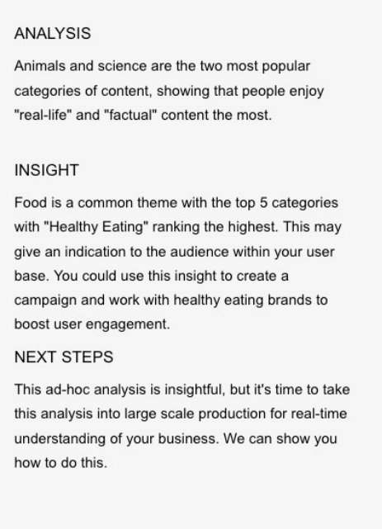

Summary

Slide 11

Thank you!
ANY QUESTIONS?

